Slide 1
Lecture 9: Training a binary classification model
BINF 4002

Slide 2
Feedback!
Form Link (will be distributed via courseworks): https://forms.gle/LiXN5CuLf7qZmBvT8

Slide 3
Coming Up
More ML Training!
ML Losses
ML Data Types
ML Models
ML Algorithms
Spring Break!
Health/bio data modalities
Health/bio specific ML techniques

Slide 4
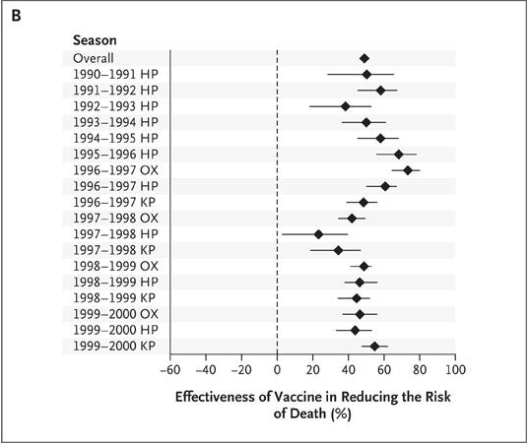
Influenza Vaccine Efficacy in the Elderly
Nichol et al report a reduction in all-cause mortality of ~50% in the elderly due to the influenza vaccine.
Is there a problem?
Nichol, K. L., Nordin, J. D., Nelson, D. B., Mullooly, J. P., & Hak, E. (2007). Effectiveness of influenza vaccine in the community-dwelling elderly. New England Journal of Medicine, 357(14), 1373-1381.

Slide 5
Outline
Last time: Evaluation of a binary classification model.
This time: How do we make that 𝑓 in the first place? (at a high level)

Slide 6
At a high level, the ML pipeline is: Identify loss, Optimize, Don’t overfit.
Loss is any function that approximates your deployment/use-case error.
Optimize some class of learnable functions to minimize that loss on an observed sample of data.
Don’t overfit; leverage things like hyperparameter tuning, monitoring, regularization.

Slide 7
Outline
Last time: Evaluation of a binary classification model.
Given a fixed model 𝑓, how do we judge performance?
This time: How do we make that 𝑓 in the first place?
Before the model:
Data Splits
Model capacity / misspecification
Procedural View
K-nearest-neighbors
Consistent Learning Framework
Optimization -- Performance is Efficiency
Optimization View
Solve a loss function
What is our goal? Perfect or not perfect loss?

Slide 8
Notation and Setup
Let our model be a function 𝑓_{𝛝}: 𝒙 ↦ 𝑠 ∈ ℝ trained on a binary classification task over a dataset 𝑿✕𝐲, 𝑦_{𝑖} ∈ {0, 1}, such that for input 𝒙, our model produces score 𝑠.
Let us define the random variables 𝘅, 𝗒, 𝘴 to correspond to the inputs, labels, and model produced scores---so 𝘴 = 𝑓_{𝛝}(𝘅)---with probability density functions 𝑝_{𝘅}, 𝑝_{𝗒}, 𝑝_{𝘴}.
Let us further define the random variables 𝘴₁ and 𝘴₀ to correspond to the scores returned only when the true labels are 1 and 0, respectively, with probability density functions 𝑞₁ and 𝑞₀. At times we may assume that 𝘴 is normalized to a probability output.
Let’s define 𝑅: 𝑠 ↦ {0, 1} be our decision rule, so we predict label ŷ = 𝑅(𝑓_{𝛝}(𝒙)).

Slide 9
What do we do first?

Slide 10
We need to know what we’re trying to model!

Slide 11
The Problem (and data) Determine All
Data Modality
Modeling Problem
Target Loss
Encoder Class
Data Split
Training Algorithm

Slide 12
The Problem (and data) Determine All
Data Modality
Modeling Problem
Target Loss
Encoder Class
Data Split
Training Algorithm

Slide 13
The Information Pipeline in ML
𝘅, 𝗒
𝛝

Slide 14
The Information Pipeline in ML
𝘅, 𝗒
𝛝

Slide 15
Splitting your data lets you assess performance on the underlying data distribution- not your sampled dataset!

Slide 16
Target Use-case Implies Target Generalizability Unit
(𝒙₁, 𝑦₁)
(𝒙₂, 𝑦₂)
(𝒙₃, 𝑦₃)
(𝒙₄, 𝑦₄)
(𝒙₅, 𝑦₅)

Slide 17
Target Use-case Implies Target Generalizability Unit
By Sample?
(𝒙₁, 𝑦₁)
(𝒙₂, 𝑦₂)
(𝒙₃, 𝑦₃)
(𝒙₄, 𝑦₄)
(𝒙₅, 𝑦₅)

Slide 18
Target Use-case Implies Target Generalizability Unit
By Patient?
By Sample?
(𝒙₁, 𝑦₁)
(𝒙₂, 𝑦₂)
(𝒙₃, 𝑦₃)
(𝒙₄, 𝑦₄)
(𝒙₅, 𝑦₅)

Slide 19
Target Use-case Implies Target Generalizability Unit
By Clinic?
By Patient?
By Sample?
(𝒙₁, 𝑦₁)
(𝒙₂, 𝑦₂)
(𝒙₃, 𝑦₃)
(𝒙₄, 𝑦₄)
(𝒙₅, 𝑦₅)

Slide 20
The Problem (and data) Determine All
Data Modality
Modeling Problem
Target Loss
Encoder Class
Data Split
Training Algorithm

Slide 21
A common loss variety
Define a generative model of your data random variables 𝘅, 𝗒.
You can model both 𝘅, 𝗒 or just 𝗒 | 𝘅.
Identify the parameters for that generative model that maximize the likelihood of the data you observe.
This results in minimizing a “negative log likelihood” loss.

Slide 22
The question, then? How do we model 𝘅, 𝗒 or 𝗒 | 𝘅.

Slide 23
What is the simplest model we can use?
Label 1
Label 0
?

Slide 24
What is the simplest non-trivial model we can use?
Label 1
Label 0
?

Slide 25
Let’s separate the classes linearly?
Label 1
Label 0
?

Slide 26
Let’s guess what we’ve seen before!
Label 1
Label 0
?

Slide 27
What are we learning in the nearest neighbor model?
k (number of neighbors) or r (radius of neighborhood)
?
?

Slide 28
What are we learning in the nearest neighbor model?
k (number of neighbors) or r (radius of neighborhood)?
Kernel function (weighting distant vs. close neighbors)?
?
?

Slide 29
What are we learning in the nearest neighbor model?
k (number of neighbors) or r (radius of neighborhood)?
Kernel function (weighting distant vs. close neighbors)?
Distance function itself!
?
?

Slide 30
What are we learning in the nearest neighbor model?
k (number of neighbors) or r (radius of neighborhood)?
Kernel function (weighting distant vs. close neighbors)?
Distance function itself!
Index to make inference efficient?
?
?

Slide 31
How do we train these?

Slide 32
Hyperparameters vs. Parameters?
Hyperparameters
Usually Non-differentiable
May only indirectly influence the per-sample level prediction/loss
Often fit on the “validation” / “dev” / “tuning” set.
Parameters
Usually Differentiable
Usually directly influence the per-sample level prediction/loss.
Fit on the “train” set

Slide 33
What information is being transferred?
𝘅, 𝗒
𝛝

Slide 34
Expected Error: Bias and Variance

Slide 35
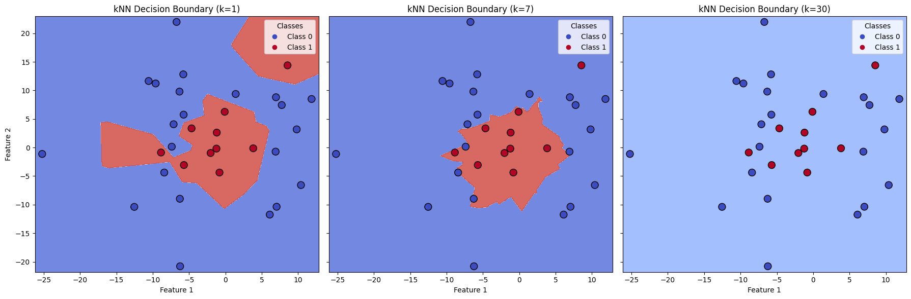
How do these values affect our expected error?
Notes:
https://colab.research.google.com/drive/1YaeNI1w4AEPgEzAmSnot2wCUnPjwSFOh#scrollTo=531a96b4

Slide 36
How do these values affect our expected error?
Bias
Variance

Slide 37
How do these values affect our expected error?
Bias
Variance

Slide 38
How do these values affect our expected error?
Bias
Variance

Slide 39
What are “bias” and “variance”?

Slide 40
Informally / Quasi-formally
An estimator is unbiased if, over the statistical process used to estimate it and all sources of randomness, its expected value equals the target property. If not, it is (statistically) biased.
The “variance” of an estimator refers to how much deviation any given sample of this estimate will take from its expected value.
The “bias” in the bias-variance tradeoff thus refers to whether a model will actually model the “right thing” and the variance refers to how much the randomness in the learning process will add uncertainty to our output.

Slide 41
What is the “right thing”?

Slide 42
We are learning over a (binary classification) problem with random variables 𝘅, 𝗒
𝘅, 𝗒
𝛝

Slide 43
The “right” output for our model to learn is precisely 𝑔(𝒙) = 𝑝_{𝗒 | 𝘅=𝒙}

Slide 44
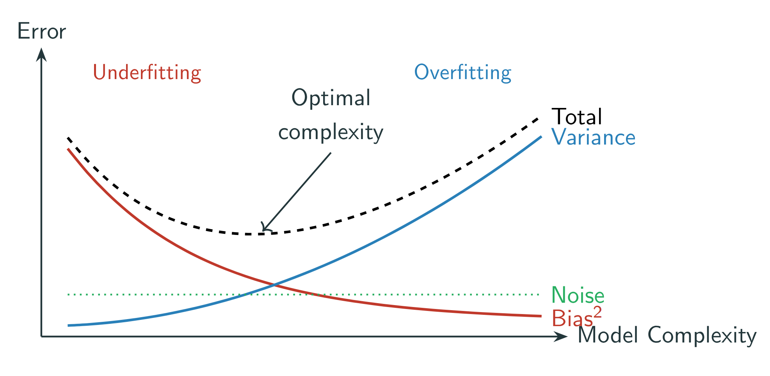
Model “Capacity” or “Complexity” reflects the model’s ability to fit complex functions. As capacity increases, bias decreases and variance increases.

Slide 45
What are the sources of this “variance” / “uncertainty”?
Training dataset sample.
Hyperparameter choice.
Parameter Initialization.
Stochasticity in algorithm.
Test sample*.

Slide 46
How do we assess uncertainty?

Slide 47
We may need to repeat our split many times
By Clinic?
By Patient?
By Sample?
(𝒙₁, 𝑦₁)
(𝒙₂, 𝑦₂)
(𝒙₃, 𝑦₃)
(𝒙₄, 𝑦₄)
(𝒙₅, 𝑦₅)

Slide 48
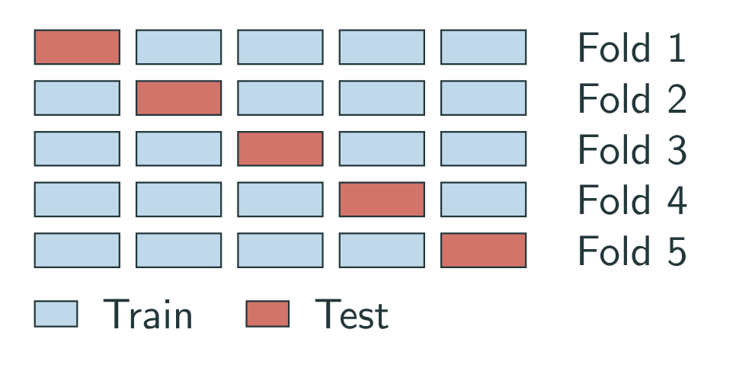
We may need to repeat our split many times

Slide 50
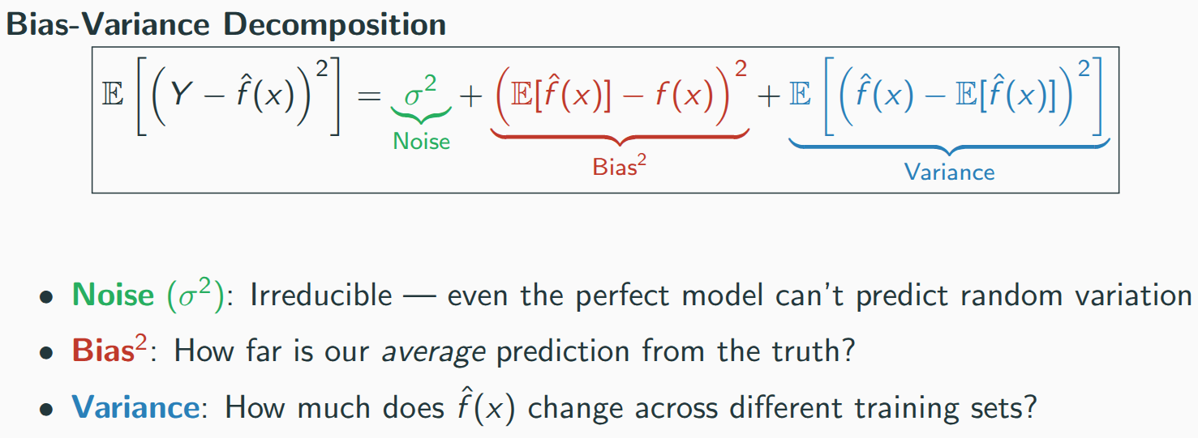
Expected error draws from three sources

Slide 51
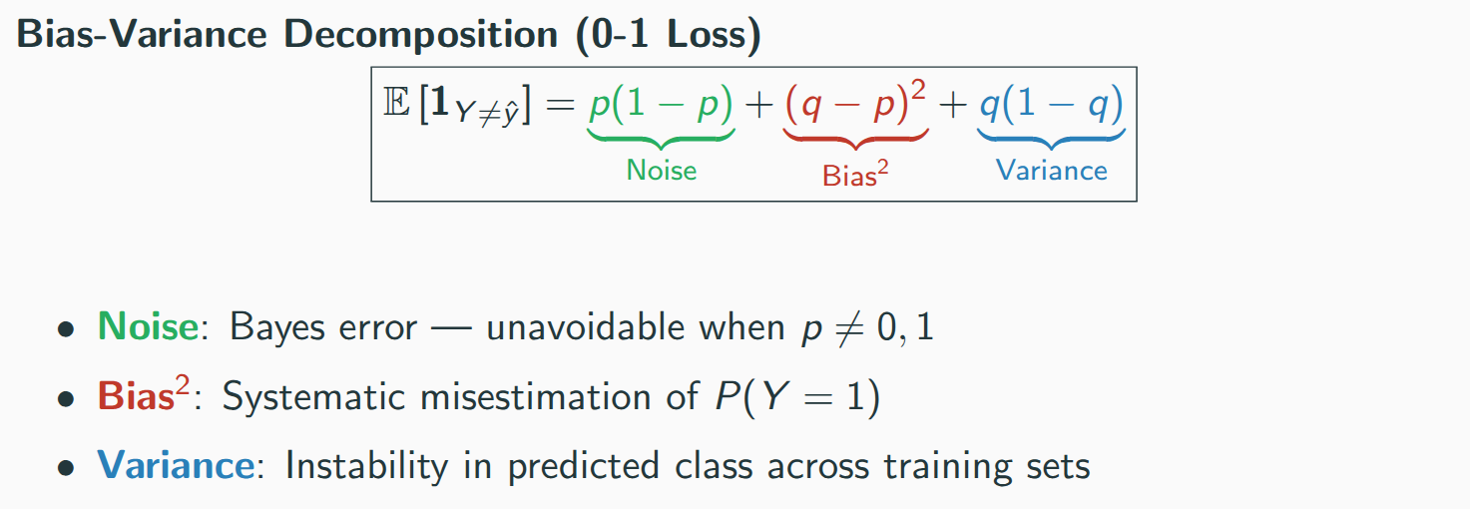
WARNING: Not mathematically same objects as MSE.

Slide 52
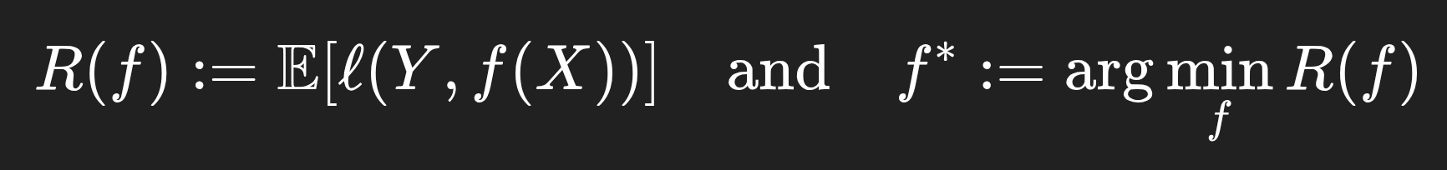
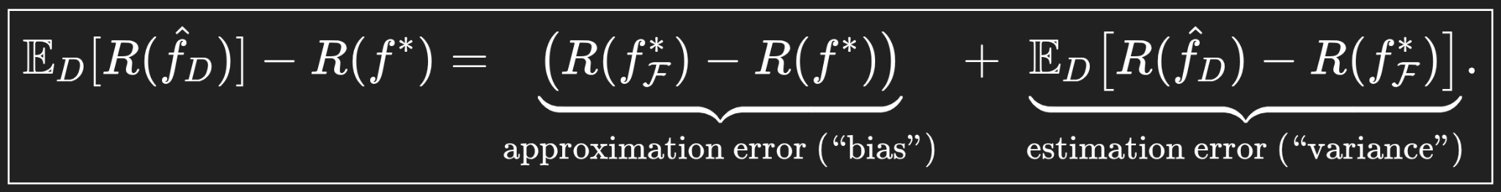
Most General

Slide 53
